Slide 1
Freelancing Application MERN
By
I.Mohamed Sameer(211521243099)
R.Lakshmikanth(211521243095)
D.Mugilvaanan(211521243101)
S.Kishore(211521243093)

Slide 2
Abstract:
This research paper explores the development of a freelance platform utilizing the MERN stack, a robust combination of technologies including MongoDB, Express.js, React.js, and Node.js. The platform aims to connect freelancers with clients, facilitating efficient project management and secure payment transactions.

Slide 3
Introduction:
SB Works is a cutting-edge freelancing platform designed to meet the evolving needs of both freelancers and clients in today's dynamic digital landscape. Built on the powerful MERN stack (MongoDB, Express.js, React.js, and Node.js), SB Works offers a seamless, secure, and efficient environment for managing freelance projects. The platform provides freelancers with personalized profiles, secure payment gateways, real-time communication tools, and advanced project management features, while offering clients easy access to top talent and project tracking capabilities. SB Works aims to bridge the gap between freelancers and clients, fostering a collaborative, transparent, and empowering ecosystem for all users.

Slide 4
Existing System:
Challenges with Current Freelancing Platforms
Limited User Experience
Complex navigation and unintuitive interfaces.
Lack of personalized features for freelancers and clients.
Inefficient Communication
Insufficient tools for real-time collaboration.
Difficulty in maintaining seamless interaction between users.
Payment Issues
Lack of secure and reliable payment gateways.
Delayed or disputed payments affecting trust.

Slide 5
Drawbacks:
Lack of Transparency
Many platforms lack proper verification systems for both clients and freelancers.
Users face difficulty trusting payment processes and project outcomes.
Limited Collaboration Features
Inefficient communication tools that hinder effective collaboration.
No real-time tracking or project milestone management features.
Insufficient Support for Freelancers
Platforms often fail to offer tools for skill development, networking, or ongoing learning.
Freelancers lack personalized support and guidance.

Slide 6
Proposed system:
User-Friendly Interface
Simplified, intuitive design for both freelancers and clients.
Customizable profiles for freelancers to showcase skills, portfolios, and experience.
Transparent and Secure Transactions
Integrated, secure payment gateways for safe transactions.
Verified user profiles to ensure trust and transparency between clients and freelancers.
Real-Time Communication & Collaboration
Built-in messaging system for direct, seamless communication.
Collaborative tools for project management, including real-time updates and progress tracking.

Slide 7
Advantages:
Robust Communication Tools
Real-time messaging and file-sharing options for smooth collaboration.
Regular notifications and alerts to keep users updated on project milestones and changes.
Freelancer Empowerment
Resources for skill enhancement and professional development.
Networking opportunities that allow freelancers to connect with other professionals and potential clients.
Cost and Time Efficiency
Streamlined processes reduce administrative work, saving time and money.
Transparent invoicing and time tracking tools ensure accuracy in billing.

Slide 8
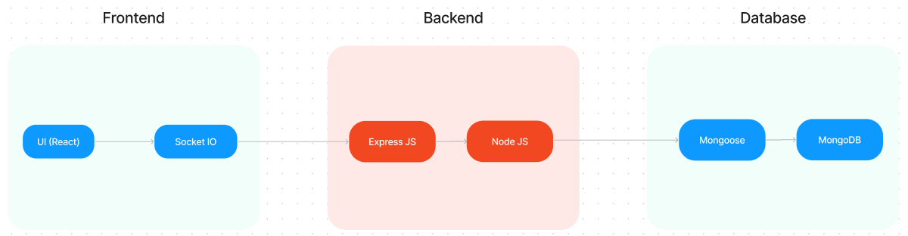
Architecture diagram:

Slide 9
Modules:
Time Tracking & Reporting
Automatic time tracking for freelancers.
Generate reports on hours worked, milestones achieved, and payments made.
Support for invoicing based on hours worked or fixed-price projects.
Freelancer Marketplace
Search and filter freelancers based on skills, experience, and ratings.
Bid on projects and negotiate terms.
Admin Panel:
Monitor user activity, project status, and transactions.
Ensure platform integrity with moderation and support tools.
Analytics for platform growth and user behavior.

Slide 10
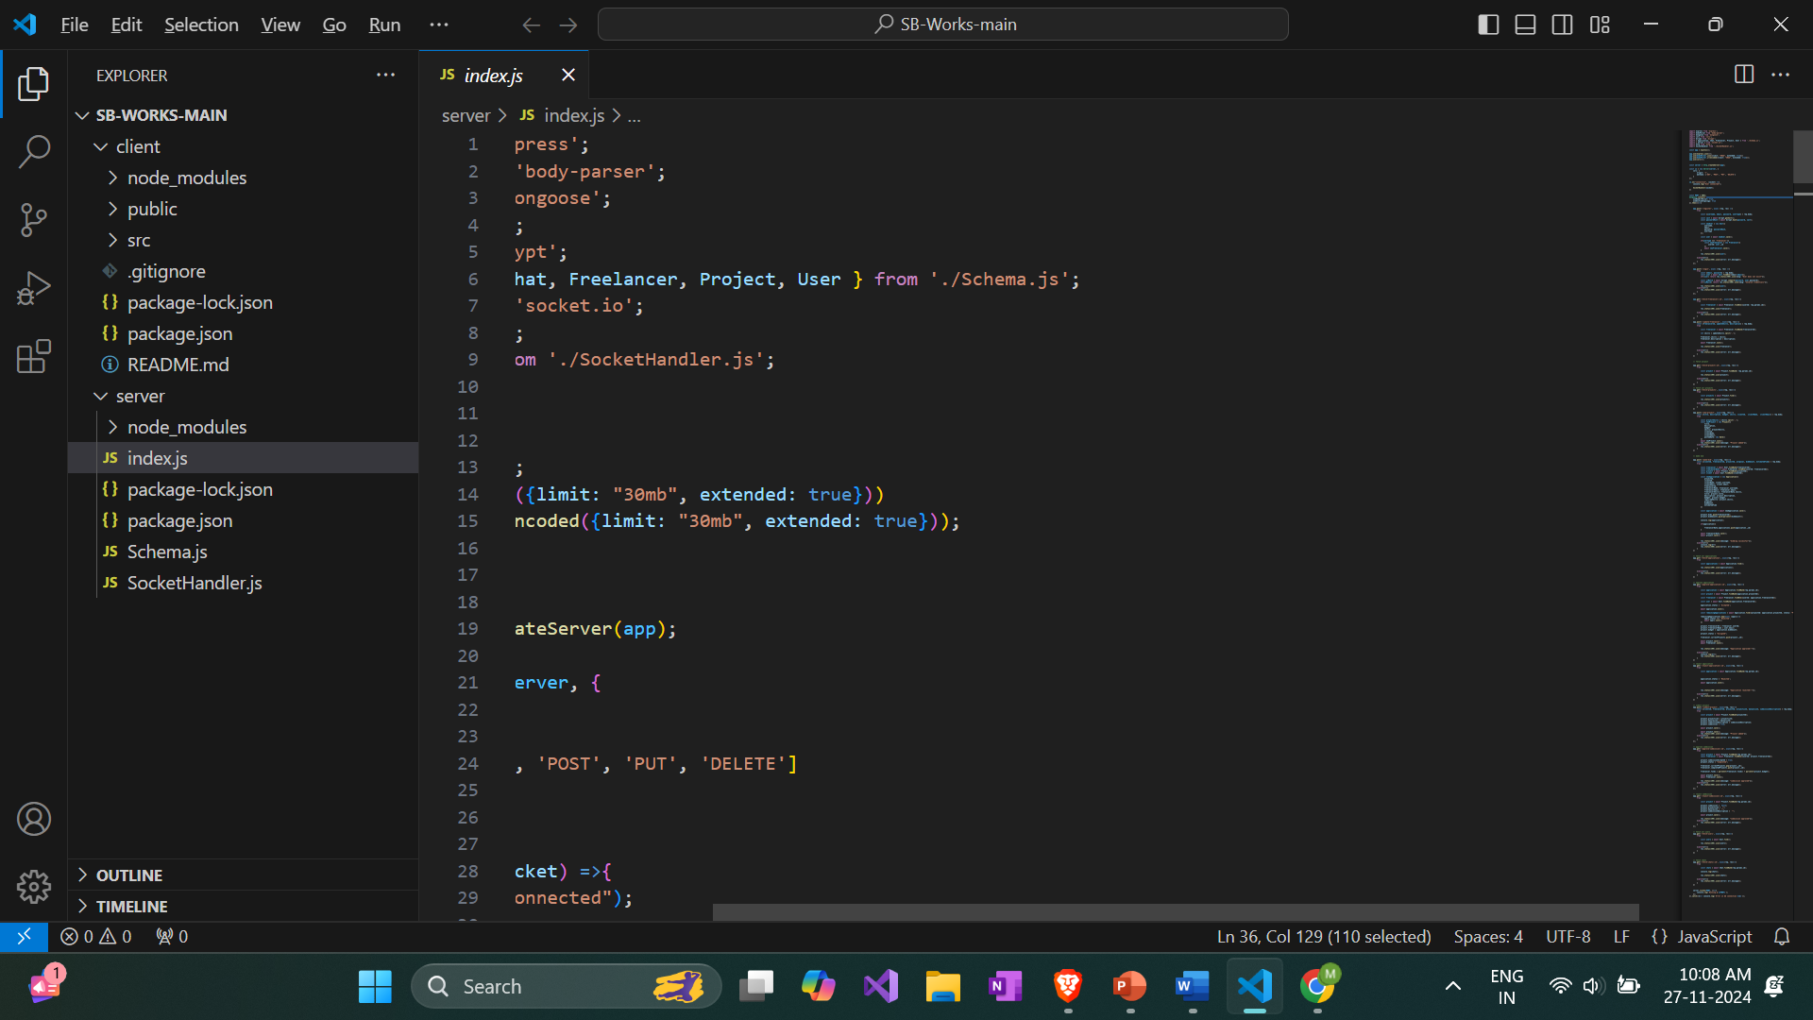
Sample code:

Slide 11
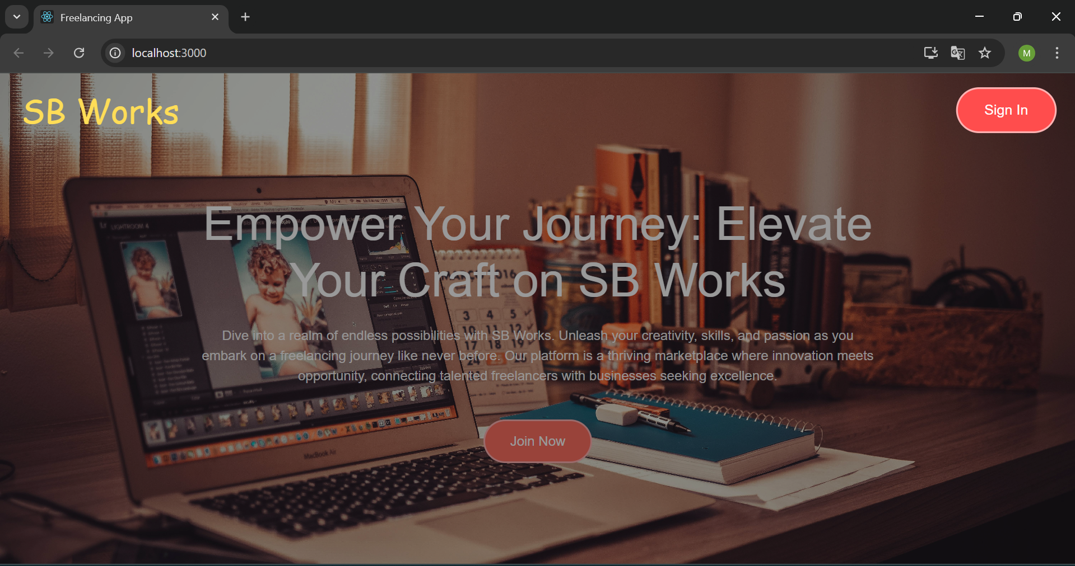
Output Screenshots:

Slide 12
Conclusion:
It aims to revolutionize the freelancing landscape by providing a comprehensive solution that enhances the experience for both freelancers and clients. With its intuitive design, secure transactions, and robust project management tools, the platform streamlines the entire freelancing process. Freelancers benefit from personalized profiles, skill development resources, and a supportive community, while clients enjoy easy access to qualified professionals and efficient project tracking. By bridging gaps in communication, transparency, and trust, SB Works creates an ecosystem where both parties can thrive and collaborate seamlessly. This platform is poised to shape the future of freelancing with its innovative approach and user-centric features.

Slide 13
Future enhancement:
Key developments include an AI-powered matching system for personalized project recommendations, a mobile app for iOS and Android with push notifications, and advanced collaboration tools such as video conferencing, screen sharing, and live editing. The platform will also integrate cryptocurrency payments and subscription models, alongside enhanced project dashboards with data-driven insights. Global expansion efforts will bring multilingual support, currency conversion, and a wider international user base. Further, enhanced user verification, a refined ratings system, and new features for talent development like e-learning courses and certifications will increase security, trust, and professional growth opportunities. These improvements will collectively transform SB Works into a more dynamic, secure, and globally accessible freelancing platform.

